Slide 1
VISION-LANGUAGE-ACTION · 3D MOTION PREDICTION
GeomVLA
Unifying Scene, Motion, and Action in 3D
A 3D motion-aware VLA framework that aligns semantic perception, latent future-motion reasoning, and action generation in one robot-centric 3D coordinate frame.
Notes:
a 3D motion-aware vla framework for robot manipulation.
central idea: align three components that are often treated separately: semantic scene perception, future-motion reasoning, and robot action generation.
Instead of reasoning in image space and acting in 3D space, GeomVLA performs both reasoning and control in a shared 3D coordinate frame.

Slide 2
MOTIVATION
Manipulation goes beyond 2D visual grounding
Most VLAs map 2D observations directly to robot actions.
Precise manipulation requires reasoning about 3D geometry, contact, and future motion.
Pretrained VLMs are optimized for 2D image statistics — a mismatch with metric 3D control.
Motion-guided policies often reason in pixel / image space, misaligned with the robot action space.
The representation–control mismatch. Policies must implicitly infer 3D physical interaction from sparse action supervision alone.
Standard VLA (no future reasoning) vs. motion-guided VLA reasoning in a 2D space.
GeomVLA
2 / 15
Notes:
Motion-guided methods help by adding future reasoning,
but many of them still predict motion in pixel or image space,
misaligned with the robot’s 3D action space.

Slide 3
KEY INSIGHT
Keep reasoning and control in the same 3D space
Motion reasoning helps most when scene, motion, and action are expressed in the same geometric space — not split across incompatible coordinate systems.
GeomVLA
3 / 15
Notes:
Key insight: future-motion reasoning is most useful when it is expressed in the same geometric space as perception and action.

Slide 4

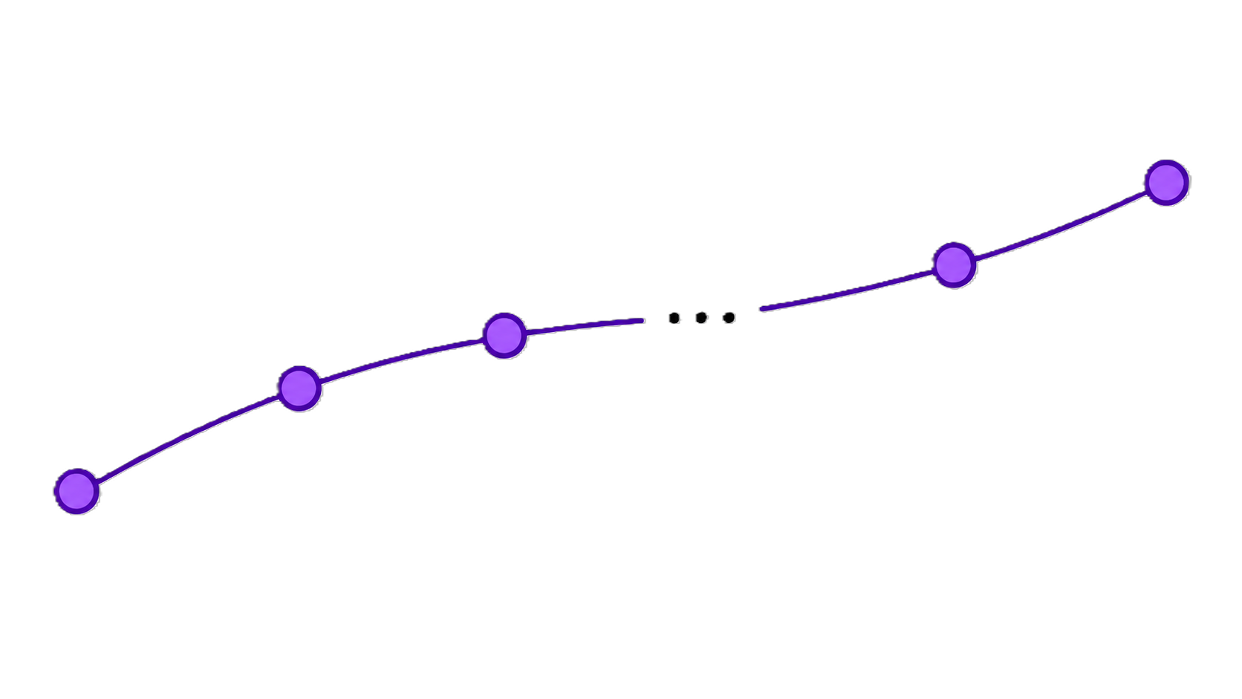
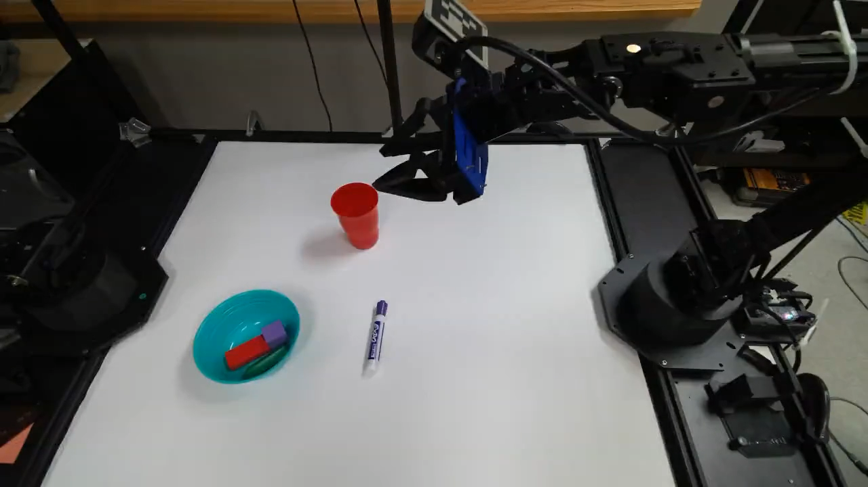
KEY INSIGHT
Keep reasoning and control in the same 3D space
PRIOR VLAs
GEOMVLA
Reasoning split across mismatched spaces
One robot-centric 3D coordinate frame
3D action
space
GeomVLA
image / pixel
motion space
≠
scene
motion
action
Motion reasoning helps most when scene, motion, and action are expressed in the same geometric space — not split across incompatible coordinate systems.
GeomVLA
4 / 15
Notes:
GeomVLA keeps scene tokens, predicted motion, and robot trajectories in one shared 3D frame.
allow the model to reason about how objects should move and how robot should act using a unified spatial representation.

Slide 5
OVERVIEW
GeomVLA bridges perception, motion, and control
Preserve VLM priors. Keep pretrained 2D visual-language features — no domain shift from full 3D pretraining.
Ground in 3D. Lift visual tokens to explicit 3D positions in the robot base frame.
Reason about motion. Predict 3D Scene Trajectories as latent geometric reasoning.
Act in 3D. Condition a flow-matching 3D action denoiser on scene, language, and motion tokens.
Lift 2D features to 3D → predict future motion → generate 3D actions.
GeomVLA
5 / 15
Notes:
This predicted motion is used as a latent geometric reasoning signal that conditions a flow-based 3D action policy.

Slide 6
METHOD
Model architecture
3D Scene Representation
Lift multi-view RGB-D features into robot-centric 3D scene tokens.
3D Scene Trajectory Denoiser
Predict future 3D displacements of task-relevant scene points.
3D Action Denoiser
Denoise end-effector trajectories from scene, language, proprioception & motion.
GeomVLA
6 / 15
Notes:
3D flow action policy denoises end-effector trajectories into clean robot actions, conditioned on scene tokens, language, proprioception, and the predicted motion representation.
All three modules use explicit 3D positions and 3D positional embeddings, keeping the policy geometrically grounded.

Slide 7
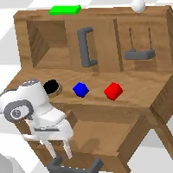
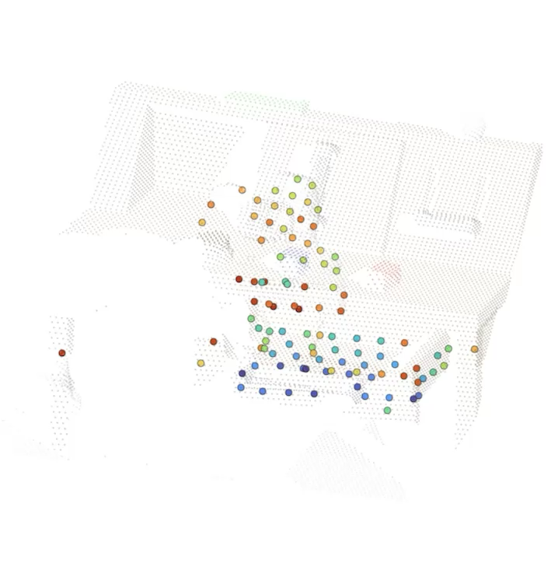
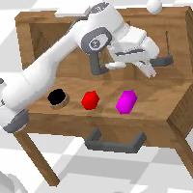
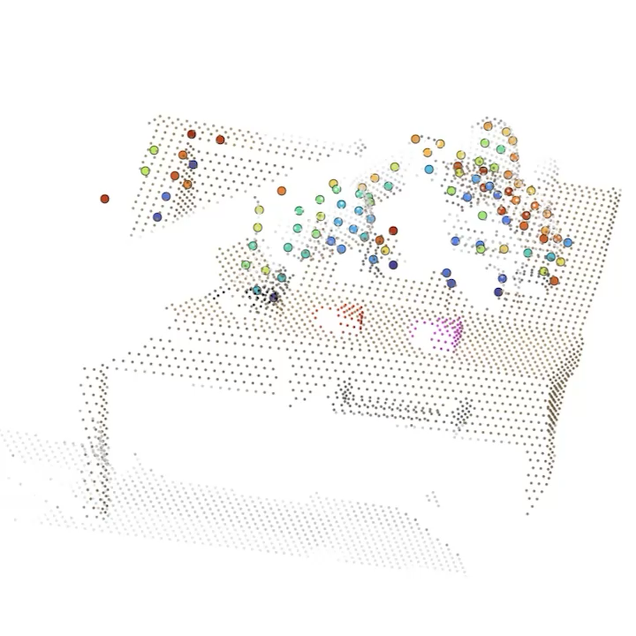
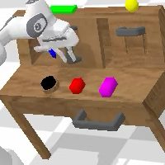
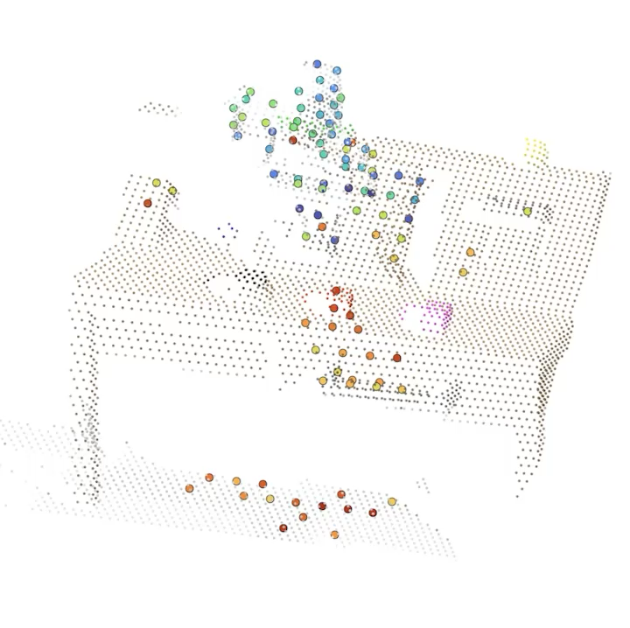
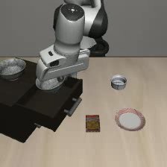
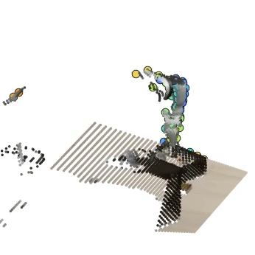
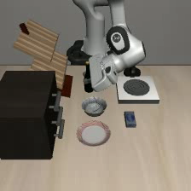
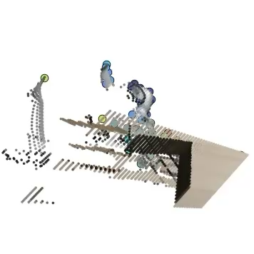
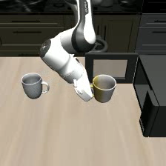
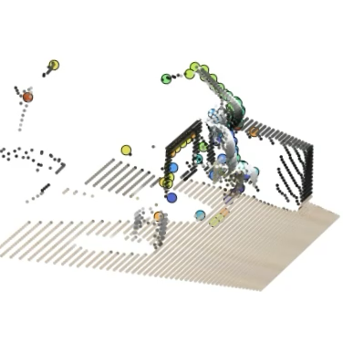
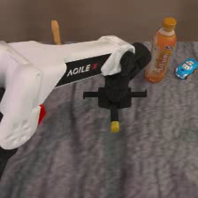
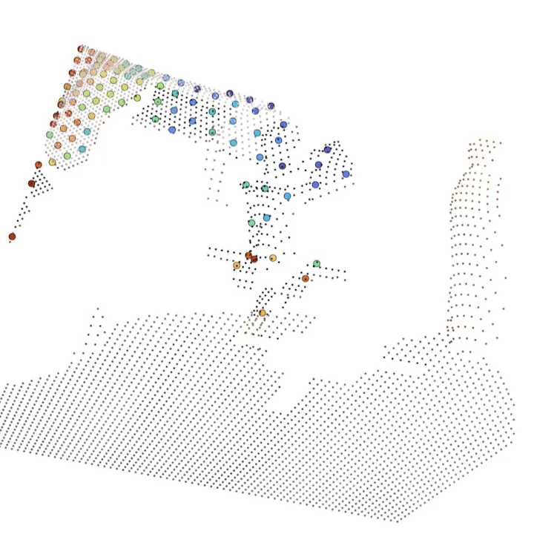
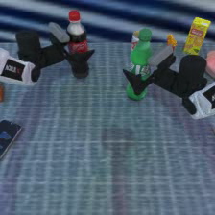
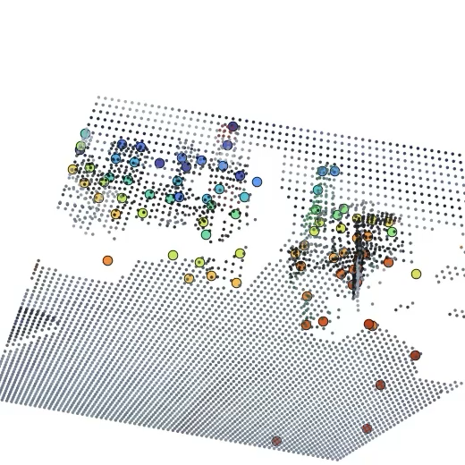
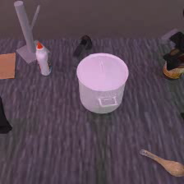
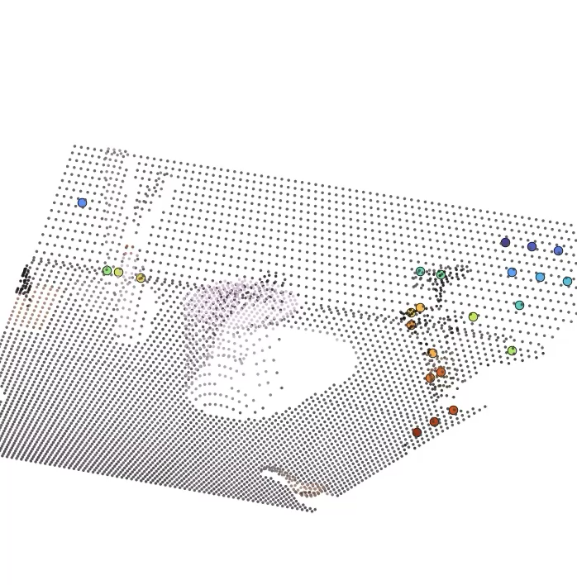
TRAJECTORY PREDICTION
Predicting task-relevant future motion in 3D
CALVIN
Predicts how scene points move under the language instruction.
Captures object, contact-induced, and gripper-relevant motion.
Supervised by 3D point tracks from demonstration videos.
Close drawer
Turn on lightbulb
Move slider left
LIBERO
Put bowl on plate
Put bottle on rack
Put mug into microwave
RoboTwin2.0
Beat block with hammer
Lift two bottles
Move can next to pot
Predicted 3D scene trajectories.
GeomVLA
7 / 15
Notes:
we visualize the predicted 3D trajectory fields across CALVIN, LIBERO, and RoboTwin2.0
We use SpatialTrackerV2 to obtain 3D point-track supervision from demo videos, with a 20-by-20 query grid and a prediction horizon of 15 future timesteps.
These scene points trajectories capture object and gripper-relevant motion for completing the language instruction.

Slide 8
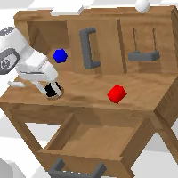
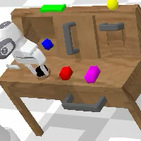
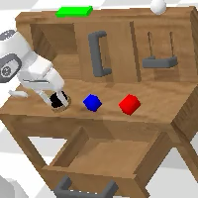
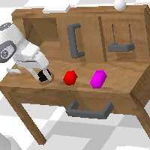
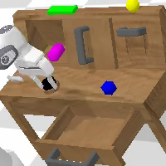
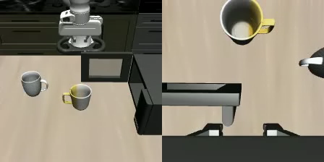
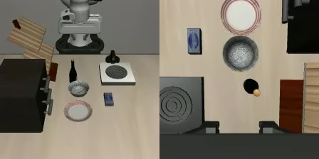
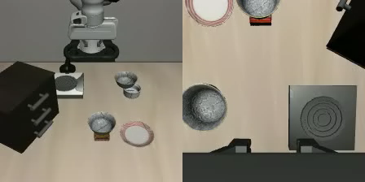
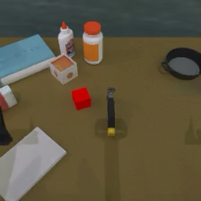
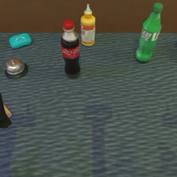
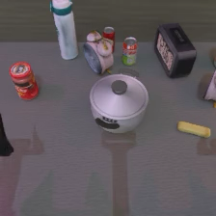
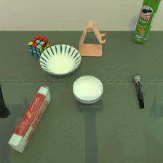
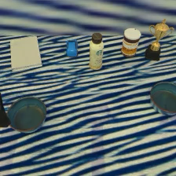
SIMULATION ROLLOUTS
Closed-loop rollouts across simulation benchmarks
CALVIN
LIBERO
RoboTwin2.0
GeomVLA
8 / 15
Notes:
closed-loop rollouts across the three simulation benchmarks

Slide 9
QUANTITATIVE RESULTS
Strong simulation performance, no robot-scale pretraining
CALVIN avg. task length / 5
RoboTwin2.0 avg. success rate %
State-of-the-art on CALVIN and LIBERO.
Competitive on RoboTwin2.0 against RL-enhanced baselines.
Future-motion helps: improves over the 3D action-only variant on every benchmark.
Data-efficient: trained only on benchmark demonstrations (1.2B params).
LIBERO avg. success rate %
Metrics. CALVIN = avg. task length (↑, max 5); LIBERO & RoboTwin2.0 = avg. success rate % (↑).
GeomVLA
9 / 15
Notes:
GeomVLA achieves strong performance without large-scale robot pretraining.

Slide 10
ABLATION STUDIES
What drives the gains: ablation studies
Future-motion reasoning alone is insufficient — gains come from 3D geometric consistency across scene, motion, and action.
CALVIN ABC→D — avg. task length (↑, max 5)
Future-motion reasoning helps.
2D: 4.411 → 4.437 · 3D: 4.508 → 4.624
Explicit 3D geometry helps.
2D → 3D action policy: 4.411 → 4.508
Geometric consistency is critical.
Image-space motion drops to 4.085 — worse than the 2D model. The motion field also beats denoised trace (4.047) and denoised latent (4.334).
w/ denoised
trace
w/ 2D
motion
w/ denoised
latent
2DGeomVLA
w/o motion
GeomVLA
w/o motion
2DGeomVLA
GeomVLA
(full)
Future-motion helps
3D geometry helps
Geometric consistency
GeomVLA
10 / 15
Notes:
geometric consistency is critical.
When we keep the 3D action policy but replace the 3D motion field with image-space motion reasoning, performance drops, even worse than the fully 2D model.
This supports our main claim: future-motion reasoning alone is not enough.
The main benefit comes when scene representation, motion prediction, and action generation all interact in the same 3D space.

Slide 11
REAL-WORLD SETUP
Real-world evaluation on ALOHA2
Three representative tasks
1
Insert marker into cup
high-precision, tight tolerances
2
Stack two blocks
contact-rich placement
3
Bottle placement (2 bottles → 2 cups)
multi-stage execution
Training protocol
50 teleoperated demonstrations per task.
One multi-task policy trained across all tasks.
No large-scale robot pretraining.
ALOHA2 platform: 2 elevated Azure Kinect DK cameras + 1 wrist-mounted RealSense D405; single-arm tabletop tasks.
GeomVLA
11 / 15
Notes:
Evaluate on real-world aloha platform.
We test three tasks with different forms of spatial reasoning and contact interaction: inserting a marker into a cup, stacking two blocks, and placing two bottles into two cups.
For each task, we collect 50 demos, and train a single multi-task policy across all three tasks.
GeomVLA is trained only on these task demonstrations, while the pi 0.5 baseline is LoRA-finetuned on the same data.

Slide 12
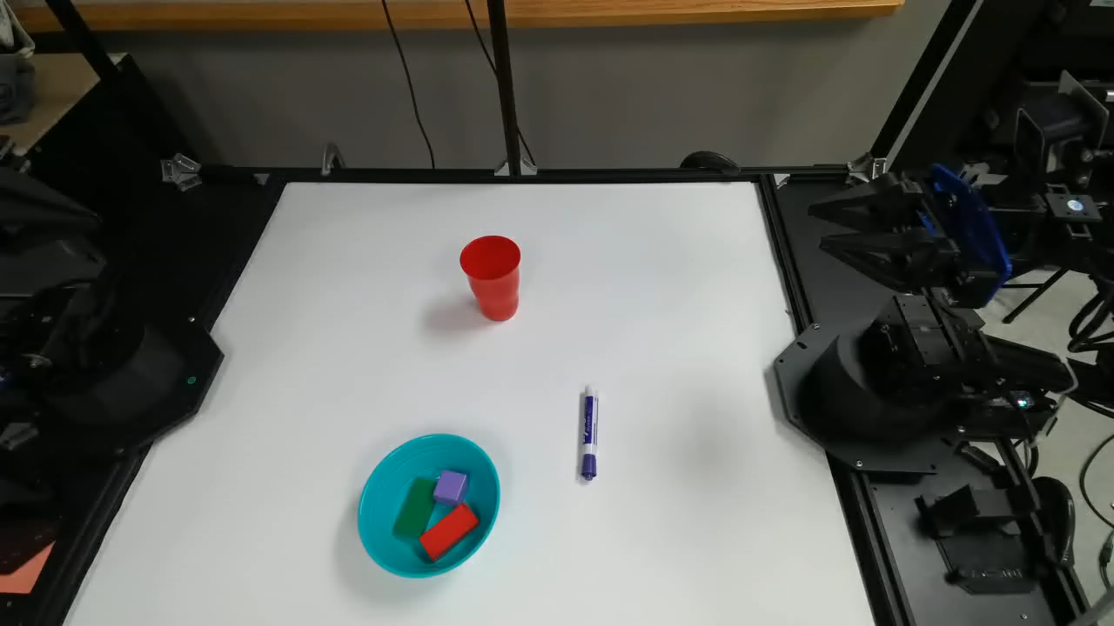
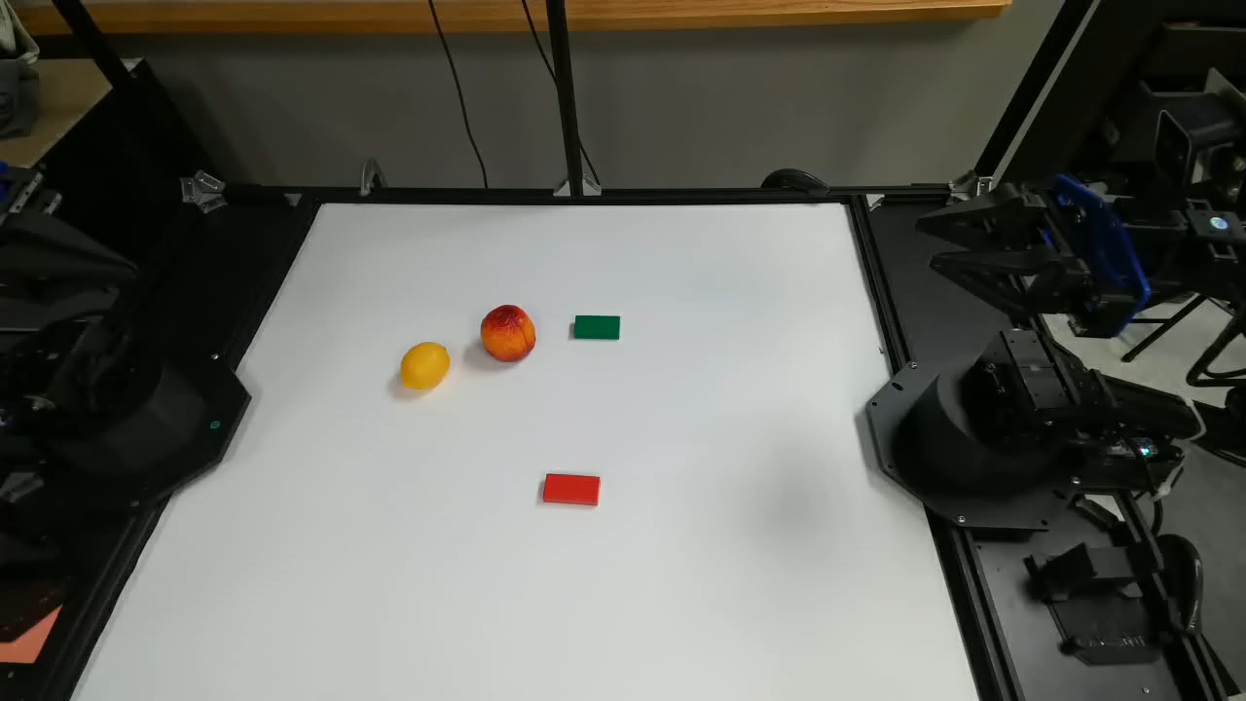
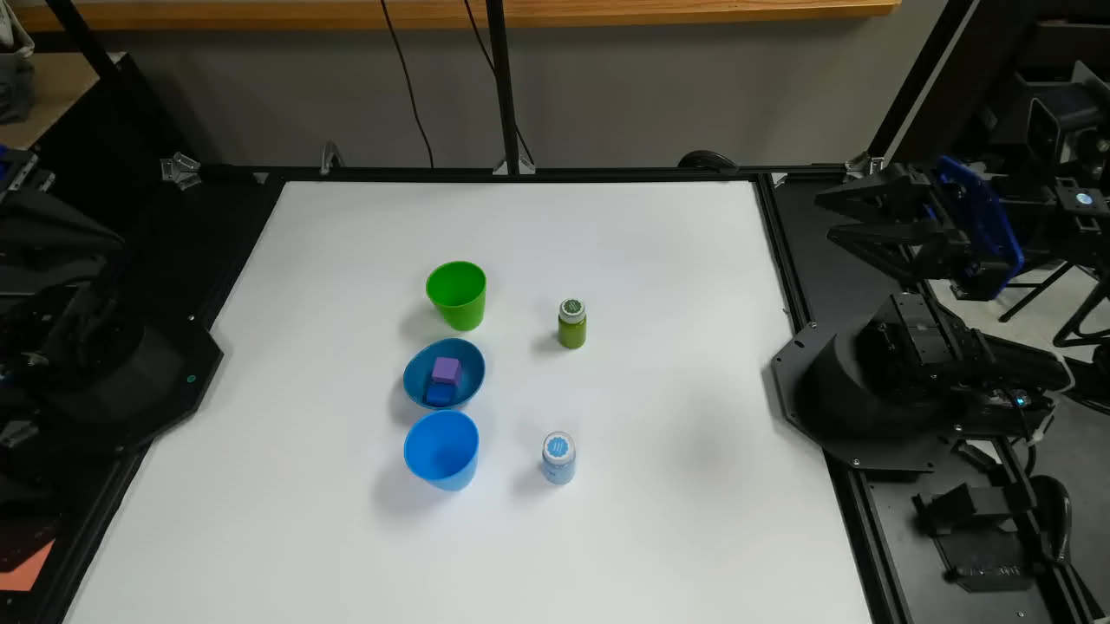
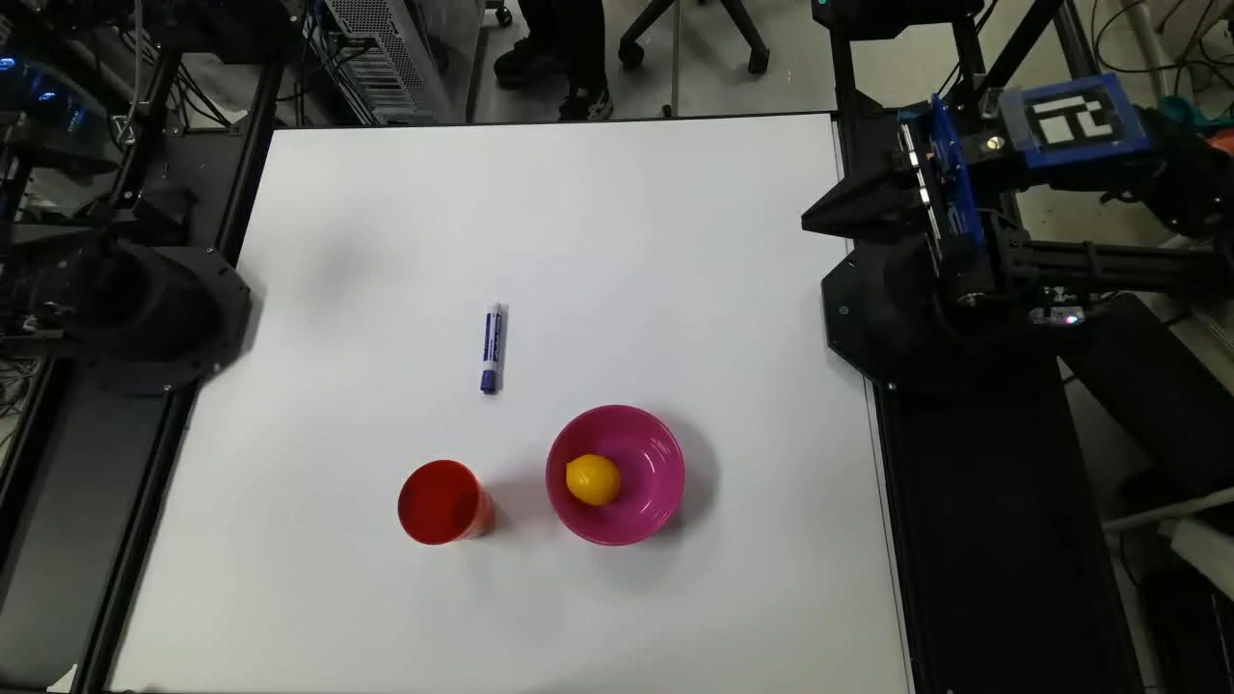
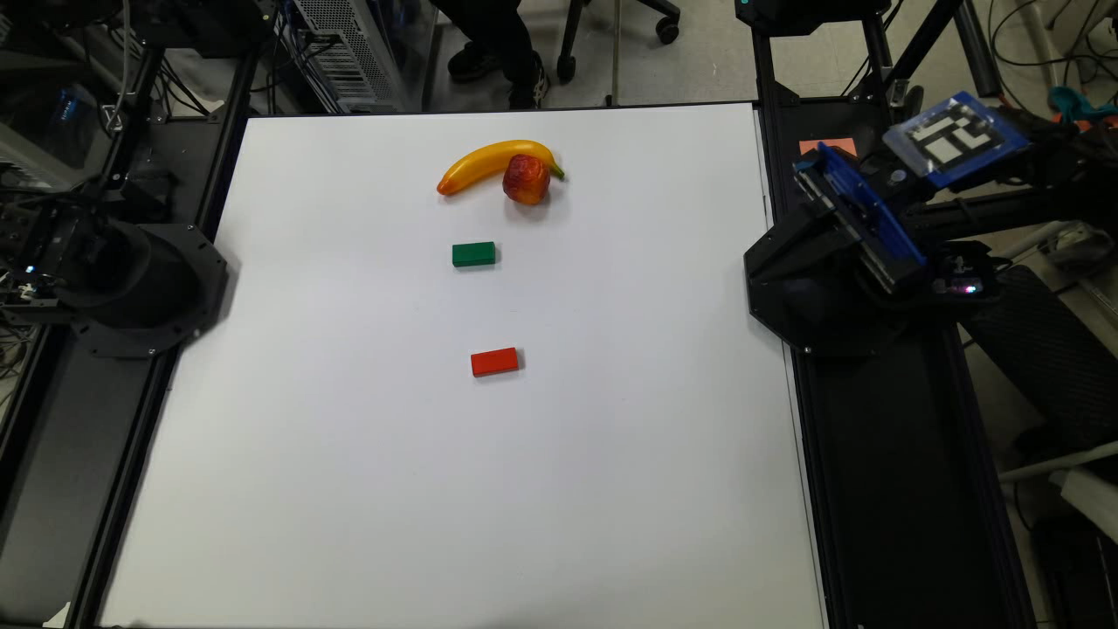
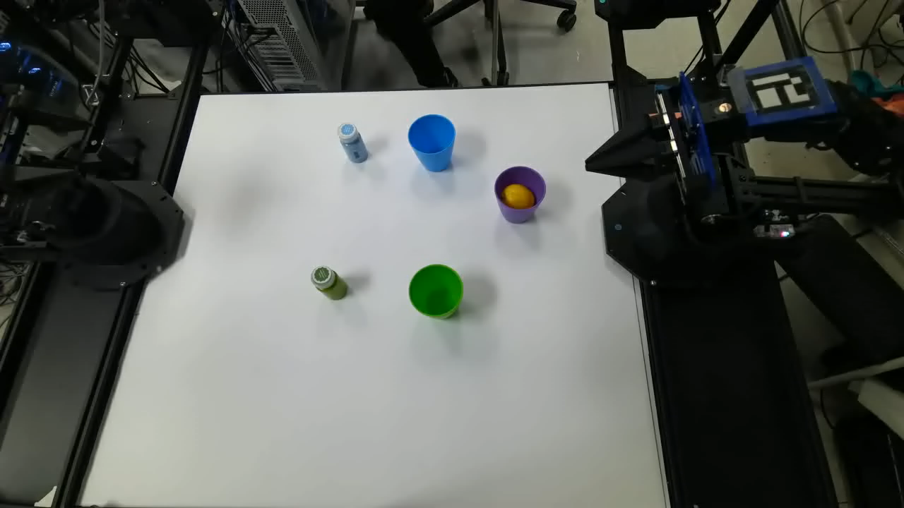
REAL-WORLD RESULTS
Real-world rollouts and success rates
GeomVLA (Ours)
Success rate (20 trials / task)
Method | Marker | Stack | Bottle
π₀.₅ | 9/20 | 2/20 | 10/20
GeomVLA | 5/20 | 19/20 | 17/20
Insert marker
Stack blocks
Bottle placement
Large gains on multi-stage tasks.
GeomVLA substantially outperforms π₀.₅ on block stacking and bottle placement.
π₀.₅ leads on marker insertion — a high-precision task sensitive to calibration and depth noise.
π₀.₅ baseline
Insert marker
Stack blocks
Bottle placement
GeomVLA
12 / 15
Notes:
Our model shows strong performance on contact-rich and multi-stage tasks.
It outperforms π0.5 in block stacking and bottle placement.
suggest that 3D motion-aware reasoning is especially useful when the policy must maintain spatial consistency across multiple stages of execution.
π0.5 performs better on marker insertion.
Our understanding is that this task is highly sensitive to calibration and depth noise, because it requires very tight geometric precision.

Slide 13
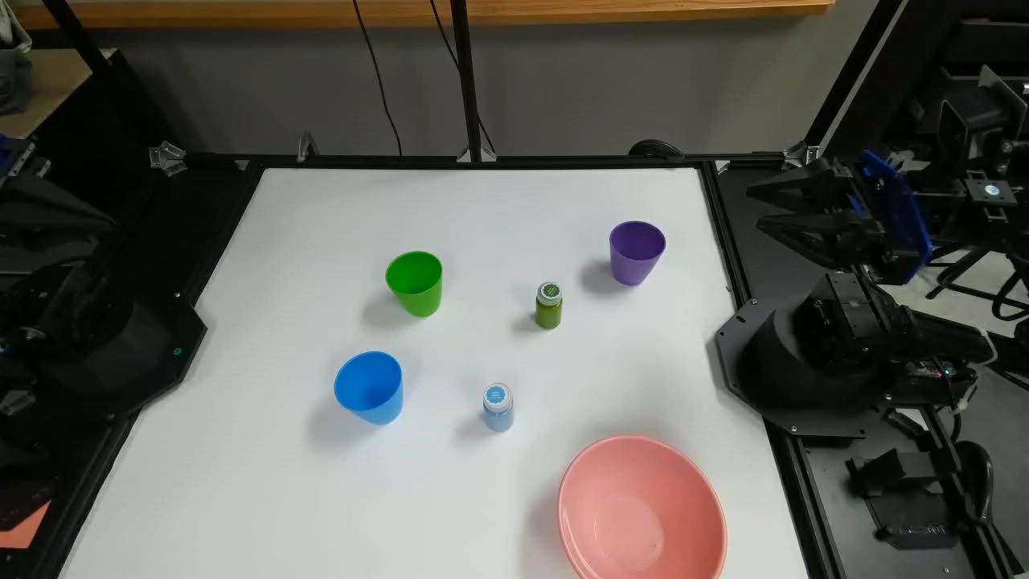
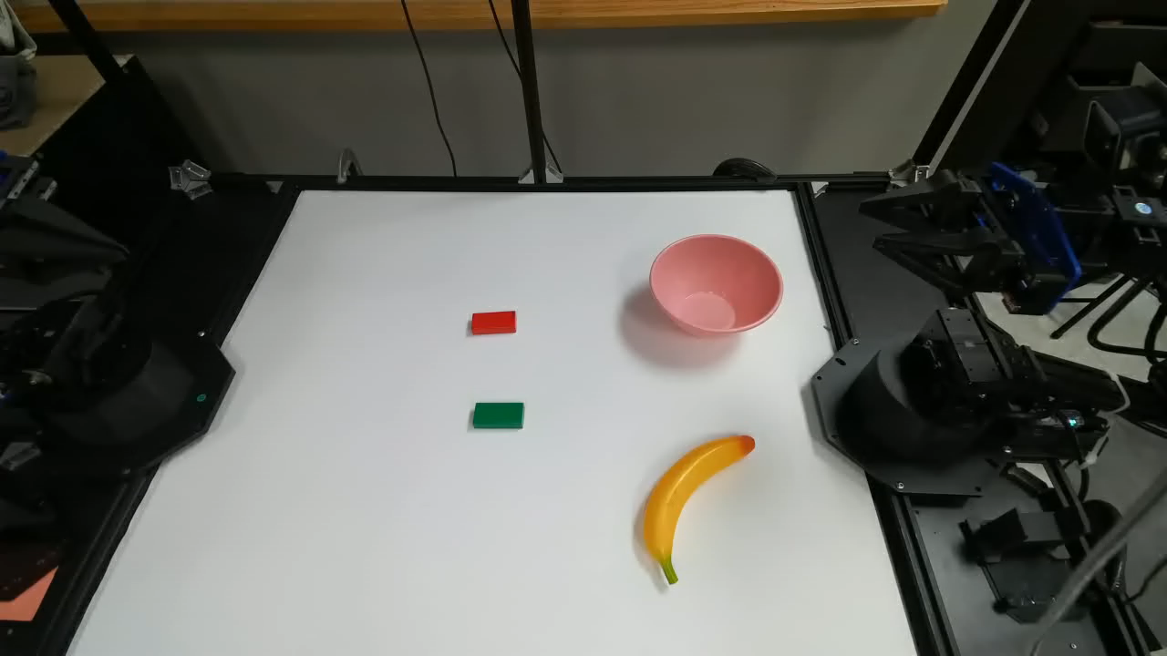
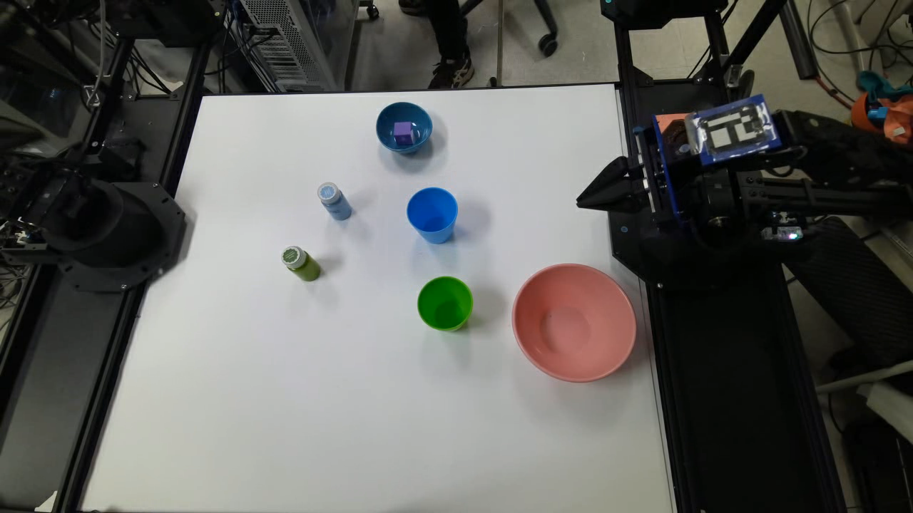
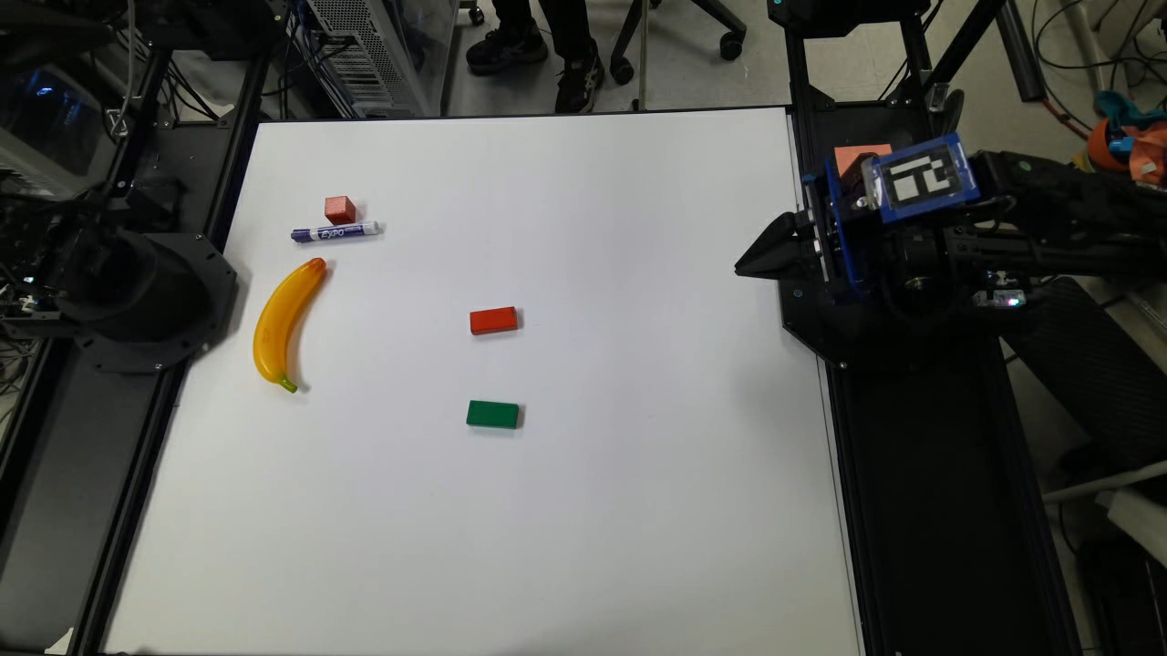
REAL-WORLD RESULTS
Emergent robustness in real-world execution
Recovers from small execution deviations.
Handles partial occlusion and object-pose inaccuracies.
Maintains task progress without explicit replanning.
Reduces compounding errors during long rollouts.
GeomVLA — robustness
Unseen distractors
Failure recovery
π₀.₅ baseline — failure cases
Why it helps. Anticipating object motion in the same 3D space keeps actions coherent under perception noise and contact-induced deviation.
Drift under distractors
No recovery
GeomVLA
13 / 15
Notes:
We observe that GeomVLA can often recover from execution errors, partial occlusions, and small object-pose inaccuracies without explicit replanning.

Slide 14

3D CHAIN OF THOUGHT
Joint Angle Action Decoder
Keep the 3D CoT (scene → motion → eef action), but decode joint angles as the executed action
CALVIN (avg. task length, max 5)
RoboTwin2.0 (5 tasks, success rate)
Real-world: insert pen (n=20)
Takeaway
Decoding joint angles while keeping the 3D scene-motion-eef CoT matches or beats the eef-action GeomVLA in simulation (CALVIN, RoboTwin2.0) and gives the largest real-world gain, 13/20 vs. GeomVLA's 5/20 and pi0.5's 10/20. Collapsing the CoT to 2D hurts every benchmark, showing 3D-aware reasoning — not the action-space choice alone — drives real-robot transfer.
14 / 15

Slide 15
TAKEWAY
Geometry-consistent reasoning for robust manipulation
Future-motion reasoning helps most when expressed in the same 3D space as perception and action.
Scene
Aligning scene representation, future-motion reasoning, and action generation in a shared 3D space leads to stronger simulation performance and more robust real-world manipulation.
Shared
3D space
Motion
Action
Notes:
Summary: GeomVLA shows that future-motion prediction is most effective when scene representation, motion reasoning, and action generation are unified in a shared 3D coordinate frame.
this points toward a direction for future VLAs that combine pretrained semantic knowledge with physically grounded 3D spatial and temporal reasoning.

